Slide 1
AD CLICK PREDICTION USING LOGISTIC REGRESSION
-- A Case Study By Imon Ghosh

Slide 2
CONTENTS
Objective of the analysis.
Dependent Variables.
Independent Variables.
Relationship Between Dependent and Independent Variables.
Significant Variables
Insignificant Variables
How The Significant Variables Affect The Dependent Variable
Graphical Representation Of The Significant Variables
Results Obtained
Understanding The Relationship Between the Variables
Business Recommendations

Slide 3
OBJECTIVE OF THE ANALYSIS
The dataset comprises of advertising data of a marketing agency. It includes variables that are likely to promote the website by drawing traffic to google ad on the website.
The main goal of this study is to understand who are more likely to click on the advertisement on the website so that the organization it can generate more revenues through it.
With respect to this objective, we are running a logistic regression model on target variable Clicked, to analyse the influence of several independent factors that affect the target variable.

Slide 4
DEPENDENT VARIABLE
‘Clicked’ represents our dependent variable in this case study.
This variable can have two possible outcomes: 0 and 1 where 0 refers to the case where a user didn't click the advertisement, while 1 refers to the scenario where a user clicks the advertisement.
We want to analyze how the independent variables can be used to accurately predict the value 'Cli.cked ' variable

Slide 5
INDEPENDENT VARIABLES
The data consists of 13 independent variables: ‘VisitID’, 'Time Spent', 'Age', ‘Avg Income', 'Internet Usage', 'Ad Topic', 'City Code', 'Male', 'Country Name', ‘Time Period’, ‘Weekday’, ‘Month’, and ‘Year'.
The number of observations in the dataset are 6657.
Ad Topic, Country Name, City Code, Male, Time Period, Weekday and Month are the categorical variables. The other variables are numerical.

Slide 6
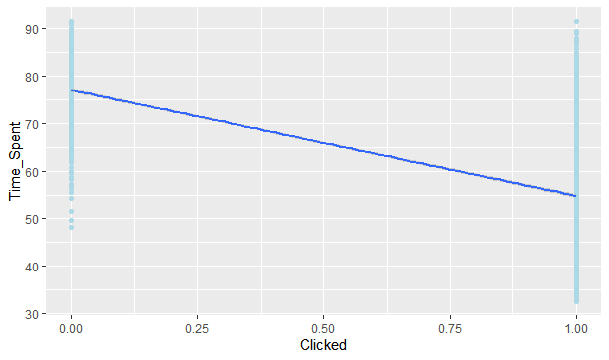
Relationship Between Dependent and Independent Variables
We can see that the relationship between Time Spent and Clicked is negative.

Slide 7
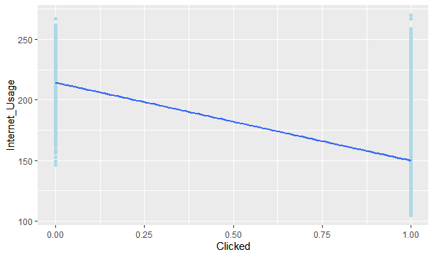
The graph represents the negative relationship between the two variables.

Slide 8
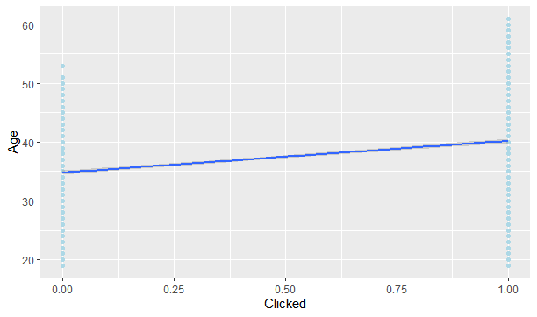
Age and Clicked are positively related.

Slide 9
SIGNIFICANT VARIABLES
Here are the list of significant variables found after building the logit regression model:
Age
Internet Usage
Male
Time Spent
Time Period

Slide 10




STATISTICALLY INSIGNIFICANT VARIABLES
The following variables were found to be statistically insignificant :
VisitID
Ad Topic
Country Name
Month

Slide 11
How The Significant Variables Affect The Dependent Variable
Age of the audience can play a key role in helping businesses identify best possible target audiences for their advertising campaigns. For example, younger audiences are more likely to click on social media related advertisements rather than the older age group. So, Age can significantly influence the dependent variable Clicked.
A higher Internet Usage , i.e, average minutes a day user spends on the internet, can lead to more traffic on the website. This can in turn lead to more chances of the ad getting clicked on.
Gender-based targeting can also be a big influencing factor in understanding whether the ad will be clicked or not. For example, if the features of the ad are more appealing to one gender, then they are more likely to click it. So, in this case, Male variable is significant for understanding whether the ad will be Clicked or not.

Slide 12
Time Spent, which refers to the average time spent by user on site in minutes, is a key factor for determining whether the ad will be clicked on the website. A higher time spent could automatically translate into higher chances of the ad getting clicked.
Time Period, which means the time at which consumer clicked on Ad, is significant for determining the next the time the user might click on the add again.

Slide 13


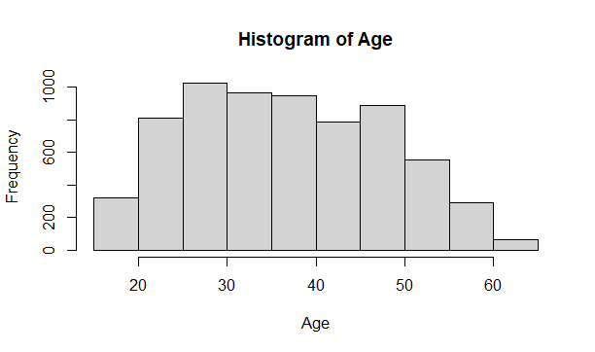
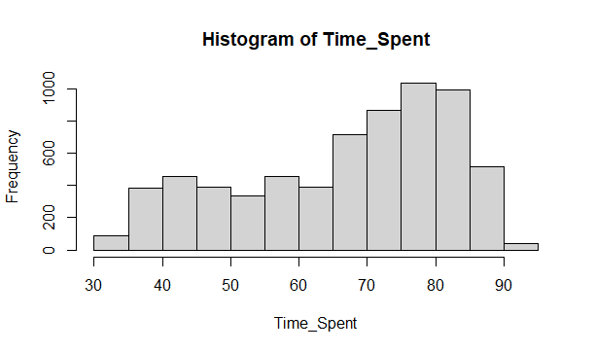
GRAPHICAL REPRESENTATION OF SIGNIFICANT VARIABLES
The histogram represents the shape and spread of the variable.

Slide 14
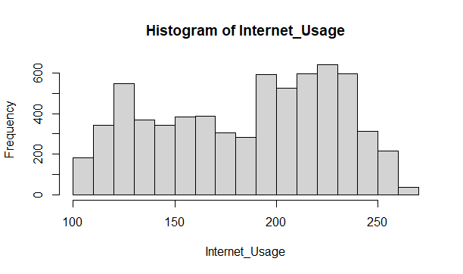

Slide 15
RESULTS OBTAINED
After removing all insignificant variables and running the linear regression model to predict life expectancy, the following results have been obtained –
ANOVA Test Results :
Age - significant : p<2e-16
Internet Usage - significant : p<2e-16
Male significant : p = 0.0253
Time Spent – significant: p <2e-16
Time Period – significant: p <2e-16
Null Deviance: 6425
Residual Deviance: 2271 Akike Information Criterion (AIC): 2283
Since AIC, Null Deviance, Residual deviance cannot give right accuracy, we build confusion matrix.

Slide 16
After building the confusion matrix, we get the following results:
1. Accuracy : 0.9319
Since the model has 93.2% Accuracy, we do not need to improve the model further.
2. Sensitivity or Recall : 0.9174
This means that the true positive rate or the proportion of actual positives which are correctly identified is 91.74% for the model.
3. Specificity : 0.9511
Also known as the true negative rate, Specificity indicates the proportion of negatives which are correctly identified in the model. Here, that is 95.1%.
4. Balanced Accuracy : 0.9343
This represents the average of the proportion corrects of each class individually.
5. Precision = 0.9489
This implies 94.89% of the result is relevant.
6. F1-Score = 0.9328
This conveys the balance between the precision and the recall. And here it indicates that the trained model has a classification strength of 93.28%

Slide 17
UNDERSTANDING THE RELATIONSHIP BETWEEN VARIABLES
Since Age variable possesses positive coefficient and hence, it can be called positive variable.
On the other hand, the following variables possess negative coefficients and hence can be called negative variables –
Internet Usage
Time Spent
Time Period
Male

Slide 18
BUSINESS RECOMMENDATIONS
To improve its revenue generating prospects from ad clicking, the organization should target younger audiences as they are more likely to click on the add than the older audience.
Also, if we are wondering whether the site is visited more by men or women, we see that the situation is almost equal. So, in that case, the organization should put equal amount of focus on targeting both the genders.
The organization should also target those who are spending a significant amount of time using the internet and using the website, given that they are more likely to click on the ad.

Slide 19
Thank You!

